Slide 1
Chapter 5:
Fitting Curves to Data
Terry Dielman
Applied Regression Analysis:
A Second Course in Business and Economic Statistics, fourth edition
Fitting Curves to Data
Copyright © 2005 Brooks/Cole, a division of Thomson Learning, Inc.

Slide 2
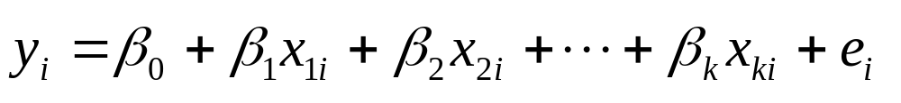
5.1 Introduction
In Chapter 4 , the model was presented as:
where we assumed linear relationships between y and the x variables.
In this chapter we find that this may not be true and consider curvilinear relationships between the variables.
Fitting Curves to Data
Copyright © 2005 Brooks/Cole, a division of Thomson Learning, Inc.

Slide 3
Modeling
curvature
In general, we regress Y on some X which is not a linear function.
Common functions are X² , 1/X or log(X)
In economics, sometimes regress log(y) on log(x)
Fitting Curves to Data
Copyright © 2005 Brooks/Cole, a division of Thomson Learning, Inc.

Slide 4
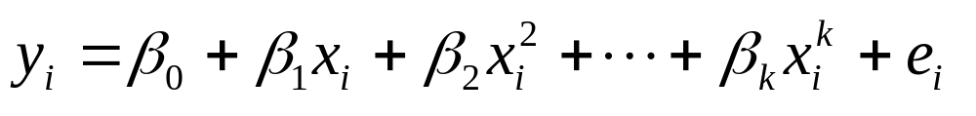
5.2 Fitting Curvilinear Relationships
Polynomial Regression – a common correction for nonlinearity is to add powers of the explanatory variable
In practice a second-order model is often sufficient to describe the relationship
Fitting Curves to Data
Copyright © 2005 Brooks/Cole, a division of Thomson Learning, Inc.

Slide 5
Example 5.1: Telemarketing
n = 20 telemarketing employees
Y = average calls per day over 20 workdays
X = Months on the job
Data set TELEMARKET5
Fitting Curves to Data
Copyright © 2005 Brooks/Cole, a division of Thomson Learning, Inc.

Slide 6
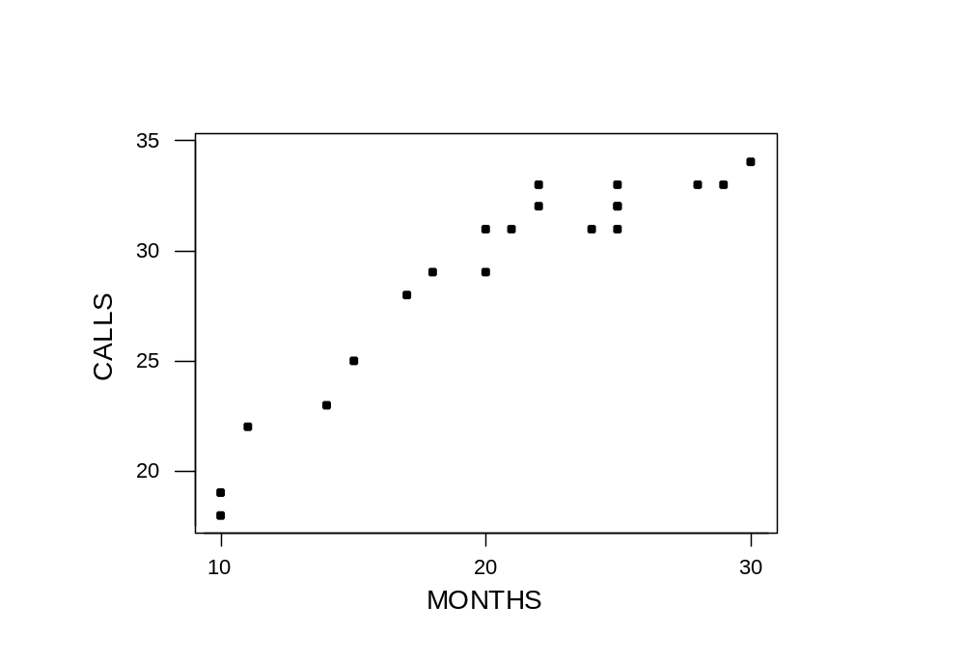
Plot of Calls versus Months
There is an increase in calls with experience, but the rate of increase slows over time.
Fitting Curves to Data
Copyright © 2005 Brooks/Cole, a division of Thomson Learning, Inc.

Slide 7
Fit of a First-Order Model
For comparison purposes, we first fit the linear equation and obtained:
  CALLS = 13.6708 + .7435 MONTHS
This equation, which has an R² of 87.4%, implies that each month of experience leads to .7435 more calls per day.
Fitting Curves to Data
Copyright © 2005 Brooks/Cole, a division of Thomson Learning, Inc.

Slide 8
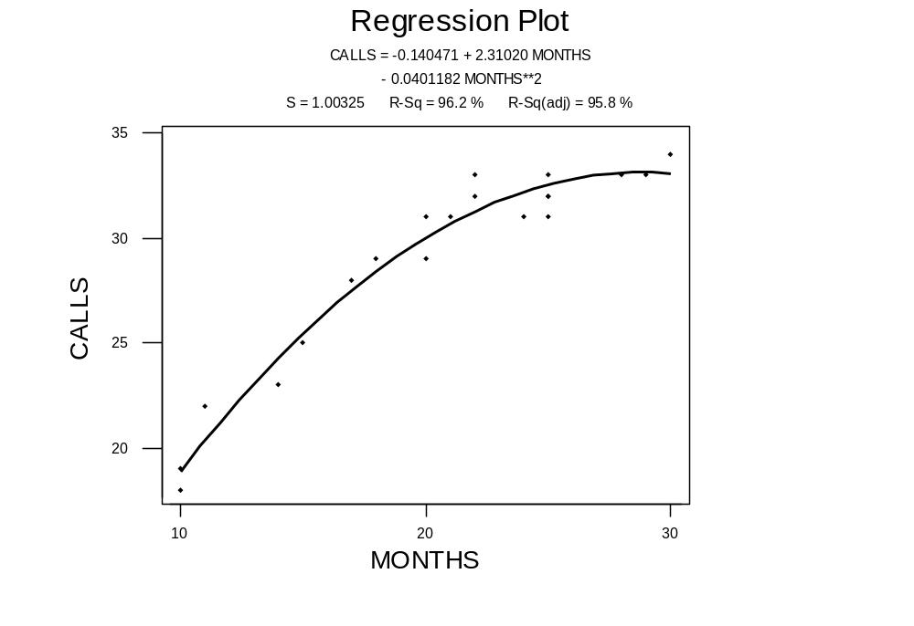
Fitting a Second-Order Model
Fitting Curves to Data
Copyright © 2005 Brooks/Cole, a division of Thomson Learning, Inc.

Slide 9
Regression Output
Regression Analysis: CALLS versus MONTHS, MonthSQ
The regression equation is
CALLS = - 0.14 + 2.31 MONTHS - 0.0401 MonthSQ
Predictor Coef SE Coef T P
Constant -0.140 2.323 -0.06 0.952
MONTHS 2.3102 0.2501 9.24 0.000
MonthSQ -0.040118 0.006333 -6.33 0.000
S = 1.003 R-Sq = 96.2% R-Sq(adj) = 95.8%
Analysis of Variance
Source DF SS MS F P
Regression 2 437.84 218.92 217.50 0.000
Residual Error 17 17.11 1.01
Total 19 454.95
Fitting Curves to Data
Copyright © 2005 Brooks/Cole, a division of Thomson Learning, Inc.

Slide 10
Hypothesis Test on β₂
H₀: β₂ = 0 (Use the linear equation)
H_{a}: β₂ ≠ 0 (Quadratic has improved fit)
Test as usual with t = b₂/SE(b₂)
Here t = -.0402/.00633 = -6.33 is significant with p-value = .000
Not surprising since R² increased 9%
Fitting Curves to Data
Copyright © 2005 Brooks/Cole, a division of Thomson Learning, Inc.

Slide 11
Hypothesis Tests "Top Down"
The usual practice is to keep lower-order terms when a high-order term is significant.
In b₀ + b₁ x + b₂ x² we would retain the b₁ term even if it had an insignificant t-ratio, if the b₂ term was significant.
Fitting Curves to Data
Copyright © 2005 Brooks/Cole, a division of Thomson Learning, Inc.

Slide 12
Higher and higher?
To see if the polynomial has even a higher order, we fit a cubic equation.
The table below shows the second-order model was sufficient.
Model | p for highest order term | R² | Adj R² | S_{e}
Linear | 0.000 | 87.4% | 86.7% | 1.787
Quadratic | 0.000 | 96.2% | 95.8% | 1.003
Cubic | 0.509 | 96.3% | 95.7% | 1.020
Fitting Curves to Data
Copyright © 2005 Brooks/Cole, a division of Thomson Learning, Inc.

Slide 13
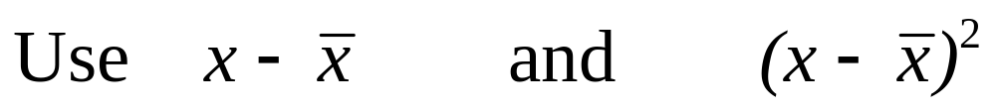
Centering the X
When polynomial regression is used, multicollinearity often results because x and x² are correlated.
This can be eliminated by subtracting x-bar (the mean) from each x
Fitting Curves to Data
Copyright © 2005 Brooks/Cole, a division of Thomson Learning, Inc.

Slide 14
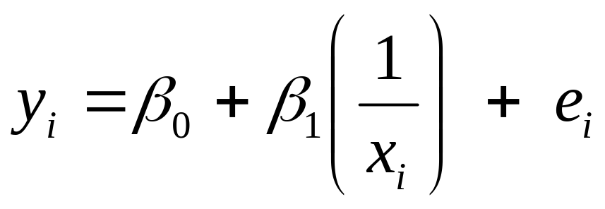
5.2.2 Reciprocal Transformation of the x Variable
Another curvilinear relationship that is in common use is:
Here y and x are inversely related but the relationship is not linear.
Fitting Curves to Data
Copyright © 2005 Brooks/Cole, a division of Thomson Learning, Inc.

Slide 15
Example 5.2
We are interested in the relationship between gas mileage and a car's horsepower.
An the next page is a plot of the highway mpg (HWYMPG) and horsepower (HP) for 147 cars listed in the October 2002 Road and Track.
Fitting Curves to Data
Copyright © 2005 Brooks/Cole, a division of Thomson Learning, Inc.

Slide 16
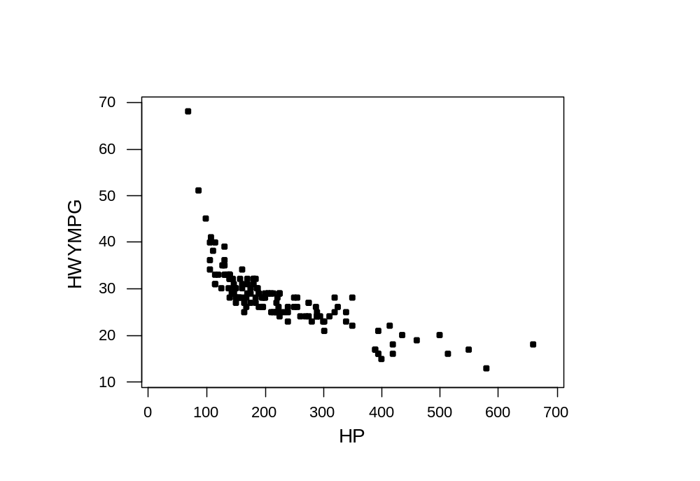
Highway MPG versus Horsepower
Fitting Curves to Data
Copyright © 2005 Brooks/Cole, a division of Thomson Learning, Inc.

Slide 17
Modeling the Relationship
A regression of HWYMPG on HP yields
  HWYMPG = 38.73 - .0477 HP with R² = 59.4%
This does not fit too well because as horsepower increases, mileage decreases, but the rate of decrease is slower for more-powerful cars.
Although other models, including a quadratic, might work, we regressed HWYMPG on 1/HP.
Fitting Curves to Data
Copyright © 2005 Brooks/Cole, a division of Thomson Learning, Inc.

Slide 18
Regression Results
The regression equation is
HWYMPG = 13.6 + 2692 HPINV
Predictor Coef SE Coef T P
Constant 13.6310 0.6493 20.99 0.000
HPINV 2962.4675 111.7526 24.09 0.000
S = 2.93107 R-Sq = 80.0% R-Sq(adj) = 79.9%
Analysis of Variance
Source DF SS MS F P
Regression 1 4987.0 4987.0 580.48 0.000
Residual Error 145 1245.1 8.6
Total 146 6232.7
Fitting Curves to Data
Copyright © 2005 Brooks/Cole, a division of Thomson Learning, Inc.

Slide 19

Data and Reciprocal Fit
Fitting Curves to Data
Copyright © 2005 Brooks/Cole, a division of Thomson Learning, Inc.

Slide 20
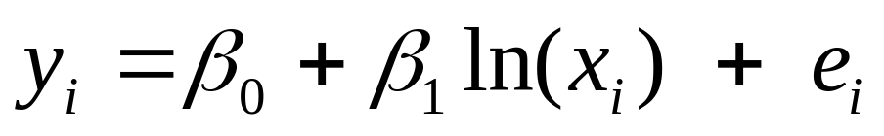
5.2.3 Log Transformation of the x Variable
Yet another curvilinear equation is:
where ln(x) is the natural logarithm of x.
It is assumed that the x values are positive because ln(0) is undefined.
Fitting Curves to Data
Copyright © 2005 Brooks/Cole, a division of Thomson Learning, Inc.

Slide 21
Example 5.4 Fuel Consumption
n = 51 (50 states plus Washington, D.C.)
FUELCON = fuel consumption per capita
POP = state population
AREA = area of state in square miles
POPDENS = population density
Data Set FUELCON5
Fitting Curves to Data
Copyright © 2005 Brooks/Cole, a division of Thomson Learning, Inc.

Slide 22
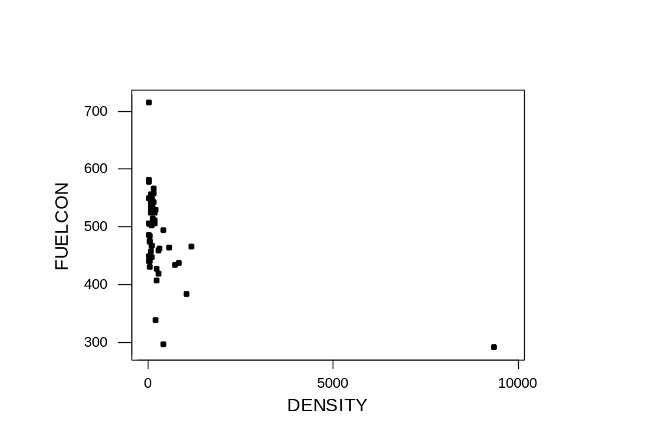
Plot of Fuelcon versus Density
r = -.454
Fitting Curves to Data
Copyright © 2005 Brooks/Cole, a division of Thomson Learning, Inc.

Slide 23
Effect of the Transformation
The graph has one point (D.C.) on the right with all others clumped to the left.
It is hard to see what type of relationship there is until some adjustments are made.
Here take the natural log of density to "pull" the extreme point back in.
Fitting Curves to Data
Copyright © 2005 Brooks/Cole, a division of Thomson Learning, Inc.

Slide 24
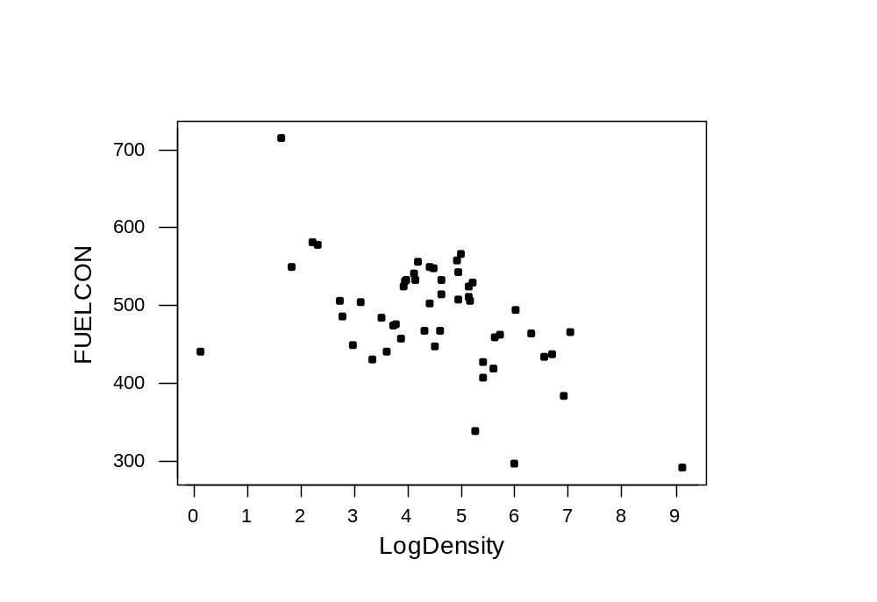
Consumption versus Logdensity
r = -.527
Fitting Curves to Data
Copyright © 2005 Brooks/Cole, a division of Thomson Learning, Inc.

Slide 25
Linear and Log Regressions
The regression equation is
FUELCON = 495 - 0.025 DENSITY
Predictor Coef SE Coef T P
Constant 465.628 9.481 52.28 0.000
DENSITY -0.025 0.007 -3.56 0.001
S = 65.1675 R-Sq = 20.6% R-Sq(adj) = 19.0%
The regression equation is
FUELCON = 597 – 24.5 LOGDENS
Predictor Coef SE Coef T P
Constant 597.19 29.96 22.15 0.000
LOGDENS -24.53 5.65 -4.34 0.000
S = 62.1561 R-Sq = 27.8% R-Sq(adj) = 26.3%
Fitting Curves to Data
Copyright © 2005 Brooks/Cole, a division of Thomson Learning, Inc.

Slide 26
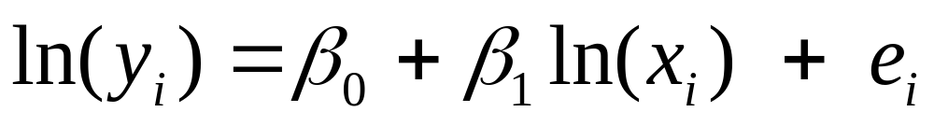
5.2.4 Log Transformations of Both the y and x Variables
Here the natural log of y is the dependent variable and the natural log of x is the independent variable:
Comparing results with other models may be difficult since we are not modeling y itself.
Economists sometimes use this to estimate price elasticity (y is demand and x price; b₁ is estimated elasticity).
Fitting Curves to Data
Copyright © 2005 Brooks/Cole, a division of Thomson Learning, Inc.

Slide 27
Example 5.4 Imports and GDP
The gross domestic product (GDP) and dollar amount of total imports (IMPORTS) for 25 countries was obtained from the World Fact Book.
For both variables, low values clump together and higher values spread out, suggesting log transformations for both.
Fitting Curves to Data
Copyright © 2005 Brooks/Cole, a division of Thomson Learning, Inc.

Slide 28
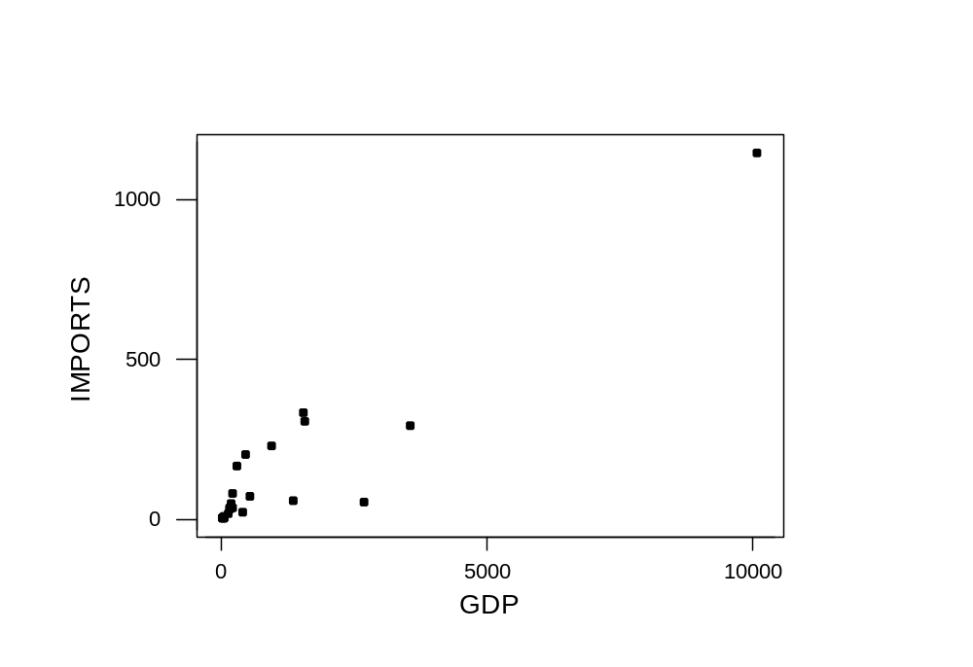
Scatterplot of Imports vs GDP
Fitting Curves to Data
Copyright © 2005 Brooks/Cole, a division of Thomson Learning, Inc.

Slide 29
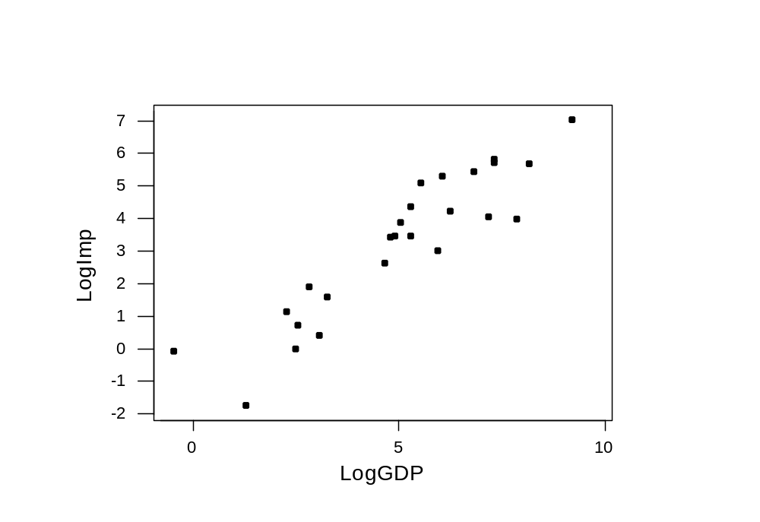
Scatterplot of LogImp vs LogGDP
Fitting Curves to Data
Copyright © 2005 Brooks/Cole, a division of Thomson Learning, Inc.

Slide 30
Two Regression Models
Regression Analysis: IMPORTS versus GDP
Predictor Coef SE Coef T P
Constant 22.32 19.24 1.16 0.258
GDP 0.105671 0.008452 12.50 0.000
S = 87.00 R-Sq = 87.2% R-Sq(adj) = 86.6%
Regression Analysis: LogImp versus LogGDP
Predictor Coef SE Coef T P
Constant -1.1275 0.4346 -2.59 0.016
LogGDP 0.86703 0.07877 11.01 0.000
S = 0.9142 R-Sq = 84.0% R-Sq(adj) = 83.4%
Not directly comparable
Fitting Curves to Data
Copyright © 2005 Brooks/Cole, a division of Thomson Learning, Inc.

Slide 31
The R² Compare Different Things
The 87.2 % R² for the no-log model is the percentage of variation in Imports explained.
The 84.0% for the second model is the percentage of variation in ln(Imports) explained.
If you converted the fitted values of the second model back to Imports you might find the log model better.
Fitting Curves to Data
Copyright © 2005 Brooks/Cole, a division of Thomson Learning, Inc.

Slide 32
What Transformation to Use
It is probably best to try several.
A quadratic is most flexible because it uses two parameters to fit the relationship between to fit the relationship between y and x.
Some further analysis is in Chapter 6 where tests for nonlinearity are discussed.
Fitting Curves to Data
Copyright © 2005 Brooks/Cole, a division of Thomson Learning, Inc.

Slide 33
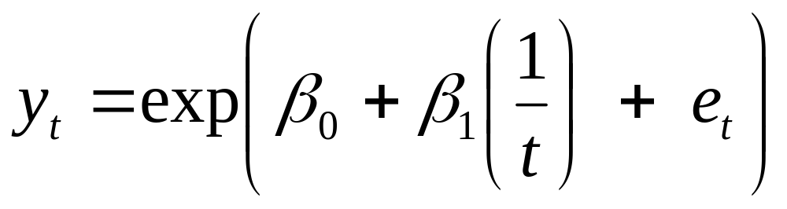
5.2.5 Fitting Curved Trends
If the data is collected over time, we may want to consider variations on the linear trend model of Chapter 3.
Another is the S-Curve trend:
Fitting Curves to Data
Copyright © 2005 Brooks/Cole, a division of Thomson Learning, Inc.

Slide 34
S Curve Model
Many products have a demand curve like this.
  Initial demand increases slowly
  As product matures, demand picks up and steadily grows.
  At some saturation point demand levels off.
Fitting Curves to Data
Copyright © 2005 Brooks/Cole, a division of Thomson Learning, Inc.

Slide 35
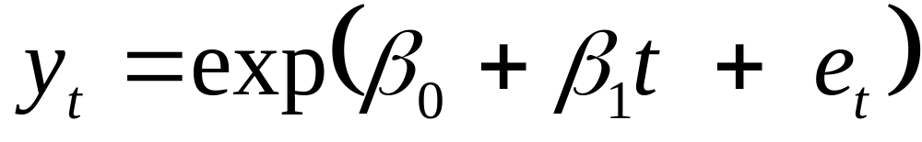
Exponential Growth Model
Another alternative is an exponential trend:
This can be fit by least squares if you model ln(y).
Fitting Curves to Data
Copyright © 2005 Brooks/Cole, a division of Thomson Learning, Inc.

